Slide 1
Self Service Publishing Project
Patrick Desbrow
Define Tollgate Review

Slide 2
BPM Project Summary
Problem Statement
As of some date December 2010, the [J D Power] Client System Group (CSG) spends approximately 22 hours or $2,000 to publish a single study on the existing Business Center web deliverable.
Currently, there are too many individual steps in a single study. The existing process is manual and requires unnecessary IT staff to ensure accuracy.
In addition, the number of reported errors on in the publishing process indicates potentials issues with quality.
Defect Definition/Project Metric
D1: Labor Hours > $1,000
D2: # of Errors > 1
Objective
The aim of this project is to
Decrease this by 50% or 11 hours of labor for a syndicated research study by December 2011.
Reduce the number of reported errors on a studies to less then or equal to one.
Leverage standardization and automation.
Standardization allows us to do the same thing the same way which also allows for the automation of common tasks.
This will lower cost and allow for more research deliverables.
Projected Benefits
Based on a current project chargeback rate of $90 per hour, it is estimated that this project would remove $1,000 from a study.
With over 300 Syndicated studies published on the Business Center in 2010, there is the potential for an estimated $300,000 savings each year.
The reduction of reported errors on each study will increase the overall quality of the study.

Slide 3
Define Key Accomplishments
Project Charter is Completed
SIPOC and VOC (Critical to Quality) has been Created
Partnered with key stakeholders and internal customers
Conducted a set of two day meetings to establish key partnerships with the research leadership in the Insurance Practice area
Identified the technology implementation steps required to publish a study on the JDPA Business Center platform
Identified and documented critical “pain points” and areas for improvement

Slide 4
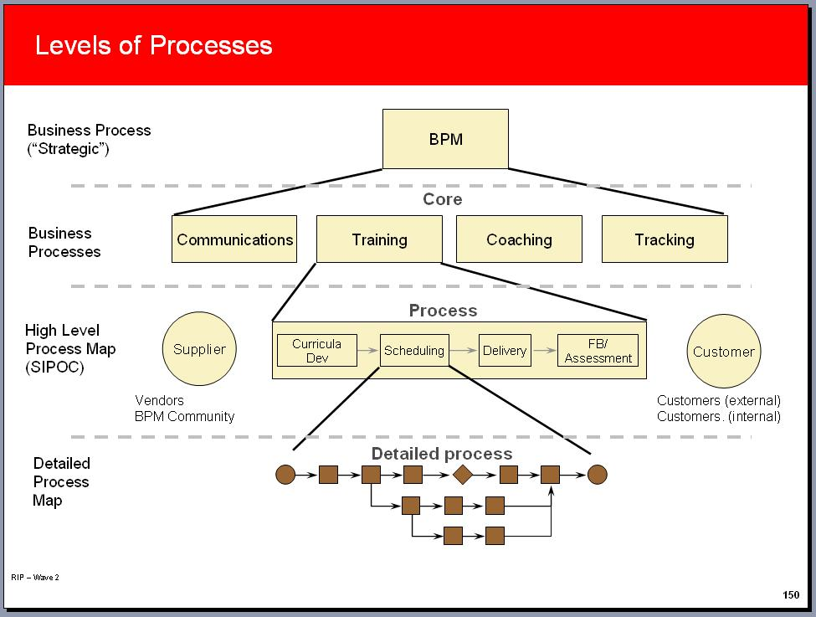
SIPOC/High level view
The focus for this project is at the end of the research process when different sources of data are delivered to the application development team in the Client Systems Group (CSG).
A detailed SIPOC mapping has been created. (Please refer to the attachment)
Suppliers: JDPA research team, respondents, vendors, and data processors
Inputs: Data files and presentation instructions uses to define the layouts and format of data, charts, and editorial content
Process: The technology process that publishes
data to the JDPA Business Center web site
Output: Research data, charts, and content
via web based delivery platform
Customer: Researcher and executives
at the JDPA client companies

Slide 5
Voice of the Customer
Critical To Satisfaction:
Technology Transformation Process
Quality
CTQ
Delivery
CTD
Cost
CTC
Accurate/ Error Free on Web Site
Timely Delivery of Data on Web Site
Low Cost Delivery on Web Site
Quality Assurance Reporting
Standard Loading Procedures
Automated Processes
Repeatability & Sustainable
Fewest Cycles to Error Fee Delivery
Reduced Dates
to Delivery
Reduced Time
to Update Data
Reduced Cost
to Deliver
Defect: > 1 Cycle
to Delivery Study
Defect: > 5 Days
to Delivery Study
Defect: > 1 Day to
Refresh Data
Defect: > $1,000 for Standard Delivery

Slide 6
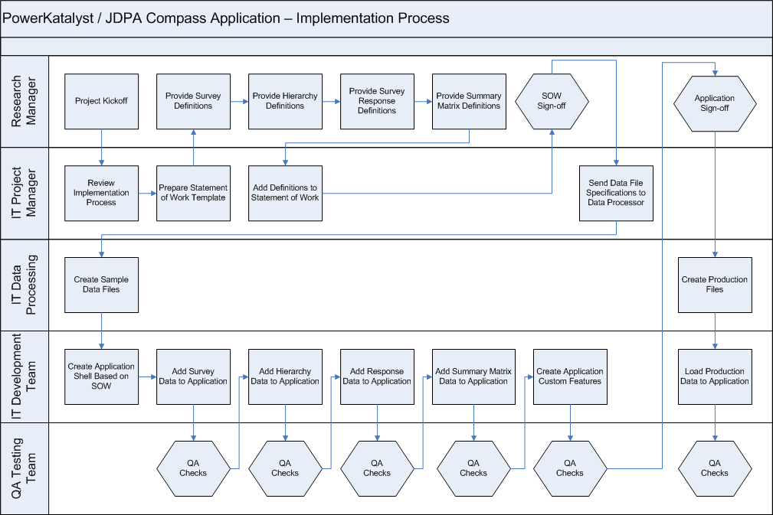
High Level Process Map

Slide 7
Major Areas for Improvement
1
2

Slide 8
Major Areas for Improvement
Load data to the production environment (Publishing Process)
    Each project can have a high degree of customization
    Programmers currently need to manually move the data and other content between servers ( loading, QA, production environments)
    This process goes through a number of cycles until correct
    This includes the list of users that will have access to the study
Numerous QA Testing Checks Through the Process
    There is a quality assurance test step for each of these manual processes
    The aims is to reduce the amount of testing before a study is delivered
    This includes checking a sample of the users that will have access to the study

Slide 9
Next Steps
Complete the Define stage by June 5th.
Define a set of quick wins for the project by June 30st.

